Slide 1


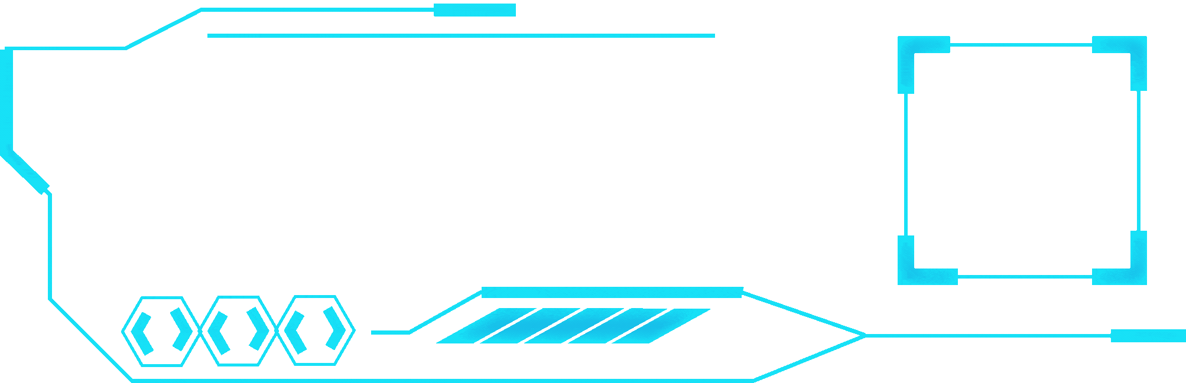


NUSH HACK
2025
Salt Category - UML Diagram Generator
By Thet Paing, Lucas and Srivikash

Slide 2
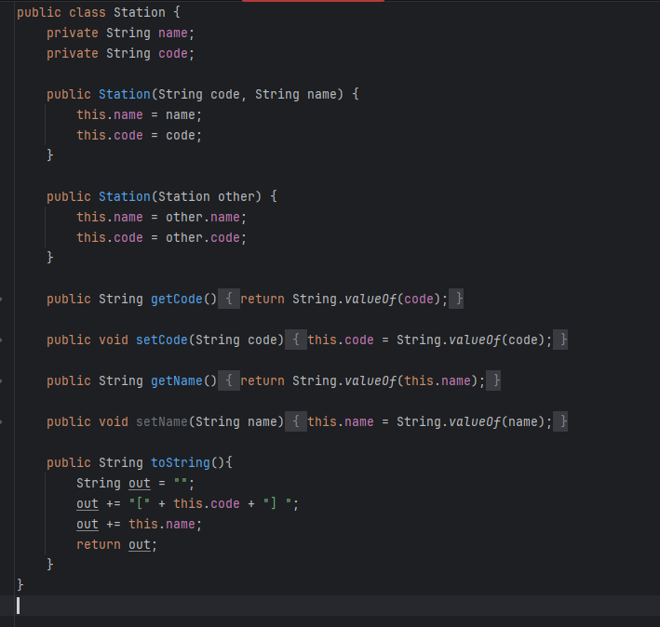
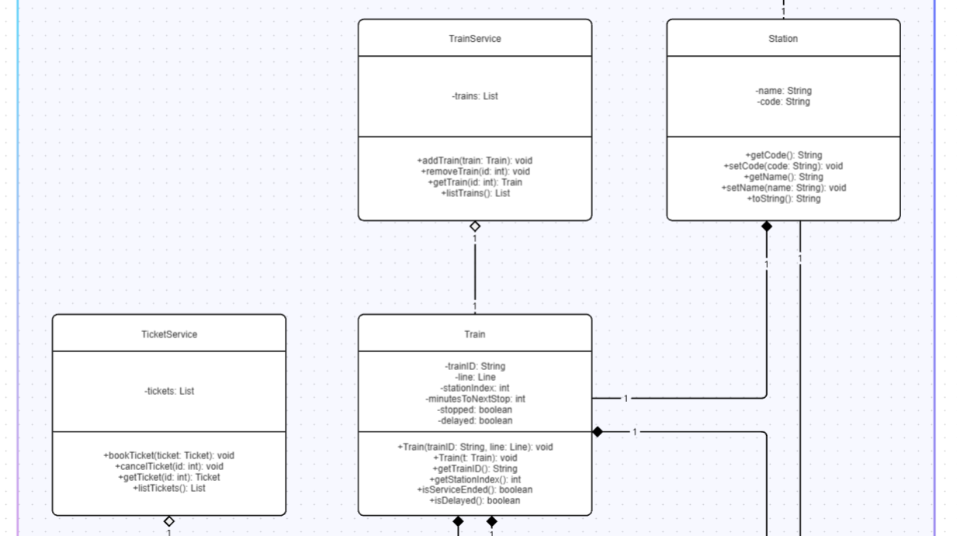
(MIRO)

Slide 3
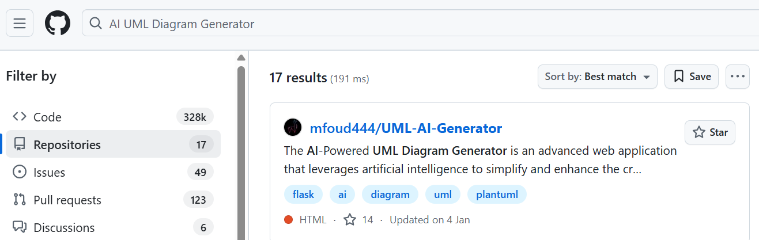
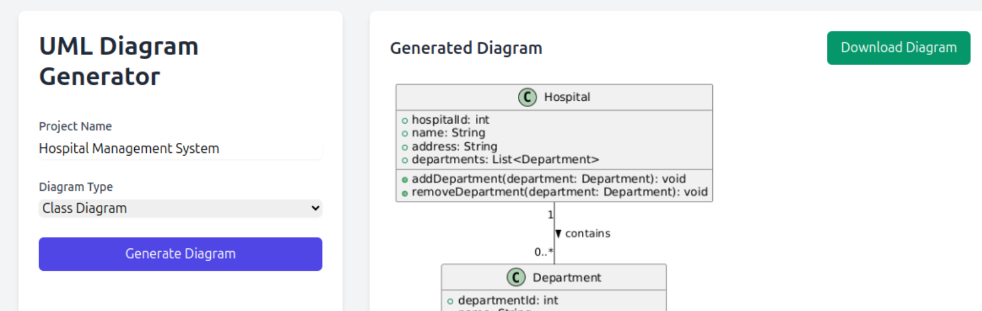

Slide 4


04
WHY?
AI probably can:
Generate UML Diagrams from projects
BUT:
Not very customisable
Most take in text prompts only
Expensive and limited access

Slide 5
OUR PROJECT
A UML Diagram Generator which generates diagrams from existing projects!

Slide 6
1
Easy UML Diagram Generation
KEY FEATURES
2
Easy Editing/Customisation
3
Save Easily to PNG/CMUD
4
Intuitive UI/UX
5
All HUMAN INTELLIGENCE!

Slide 7
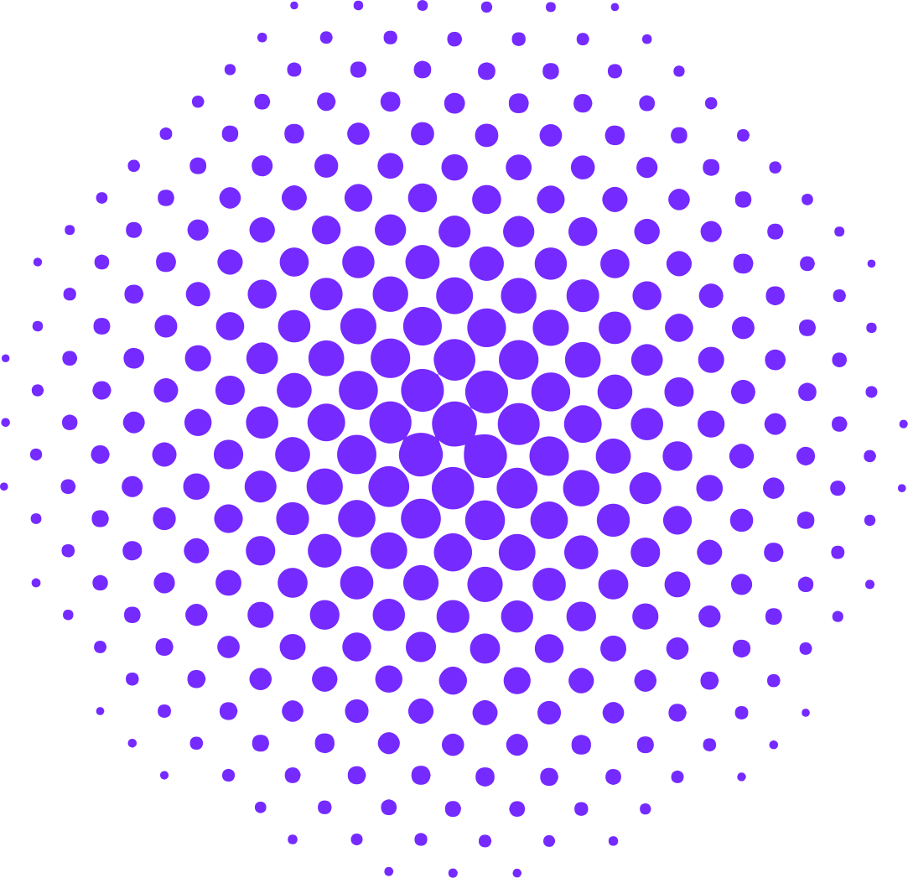

BEFORE WE MOVE ON...
Actually adapted from Thet Paing’s existing project
But not directly ripped (important code snippets only)
Completely overhauled UI/UX
Much better Formatting and Saving

Slide 8
DEMONSTRATION

Slide 9

LIMITATIONS
Limited to Java/Kotlin Projects only
Still very limited customisation options
Not very secure CMUD save format

Slide 10
FUTURE IMPROVEMENTS
07
Support for other languages (compiling on the spot instead of using already compiled files)
More advanced editor tools and customisation
Broader target audience with other tools for seasoned programmers / new coders

Slide 11



THANK YOU! :D
Thank you for taking the time to learn about our UML Diagram Generation Project!
~Keanu365, Soyuz_Dev, LuasWnog
who wants my phone number
https://github.com/Keanu365/NUSH_Hack_25_UMLGen

